Slide 1
Early American History
Settlement to the Industrial Revolution

Slide 2
Christopher Columbus discovers the American continent in 1492. The dream of colonising ‘the new world’ takes hold in Europe.
The British and the French began colonising mainland America during the late 16th century.
The British established 13 colonies on the north east coast, beginning in what is now Virginia.
The French settled further north in areas that are now part of Canada.
Thousands of Europeans from nations such as Britain, The Netherlands, Germany and others flocked to America for a fresh start, away from stagnation of European society.

Slide 3
The colonies continued to flourish, trading with each other, and mainland Europe.
The native American population is decimated by loss of land and disease. Upwards of 90% of the population succumbs to Small Pox.
British colonies set up their own systems of government in a similar fashion to their parent nation. As they became more established, their sense of independence from Britain grew.
Britain and France, historically fierce rivals, fought a war during the 1750s (The French Indian War) in which Britain narrowly emerged the victor.
The cost involved in winning the war caused the British government to vote for a tax increase across its entire commonwealth, including the new American settlements.

Slide 4
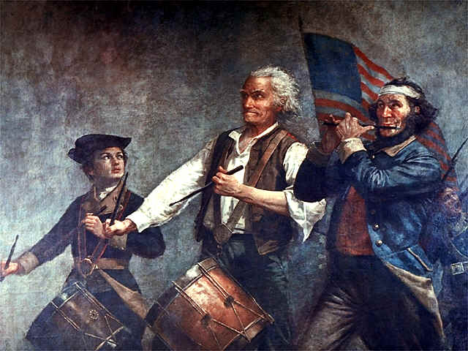
Outraged at these taxes that they felt were imposed on them by Britain for no valid reason, the American colonists elected to resist their parent nation.
Isolated conflicts between colonists and British ‘Redcoats’ quickly escalated into outright rebellion.
After some early losses, and with the help of the opportunistic French, the American colonies won their War of Independence and declared themselves free in 1783.
George Washington was declared the first American President.

Slide 5
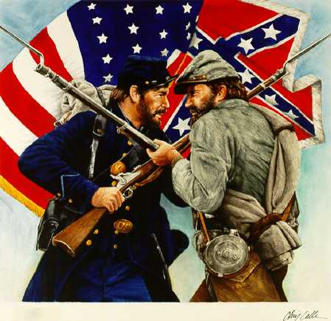
With their independence assured, the American colonies began to expand. New states and territories were settled as intrepid explorers pushed westward across the plains.
The new states and territories, while part of this new union called the United States, often had very different approaches to government and ethics.
The biggest dividing line between American states during this time was over the issue of slavery.
The northern states typically followed a tradition of free men and women working on farms and in fledgling areas of industry.
The southern states of America were firm believers in the use of slaves to provide the labour for their cotton, tobacco, tea and coffee farms.

Slide 6
A young politician from the state of Illinois called Abraham Lincoln (who was unlikely to actually have been a vampire hunter) decided that this division in ideals in this new ‘Land of the Free’ could not last.
He was a front runner in the 1860 Presidential election and, while he resolved not to outlaw slavery in the south upon attaining the Presidency, he was vocal in his opinion that it should eventually be stamped out.
A number of southern states threatened to leave the United States (or Union) if Lincoln became President. Upon his election they followed through with their threat.
States such as Texas, Alabama, Mississippi and Florida along with 5 other southern territories removed themselves from the Union and formed a Confederation of like minded governments to preserve their traditions of using slavery to staff their farm.
Lincoln, determined to preserve the United States as a unified nation, led the Northern states to war against this new confederacy in the South.

Slide 7
The American Civil War lasted for four years with the Northern Union eventually driving the Confederate forces in the South into submission.
In 1862 Abraham Lincoln issued the Emancipation Proclamation, declaring all African American slaves in the Confederate states free men & women.
Upon the Union victory in 1865 Confederate states were only allowed back into the United States if they signed on to this Proclamation and truly made African Americans citizens with the right to vote.
They did so with great resentment and little will to uphold the principles behind the concept. Slavery was replaced in the southern states with a policy of segregation which remained in evidence for the next 200 years.
A group of six disgruntled Confederate officers gathered together in the months after the war ended and decided to form a fraternal brotherhood to assist war veterans and uphold the ideals that they believed in. They derived the name of their group from the Greek work kuklos which means ‘circle’, suggesting a circle or band of brothers. They would come to be known as the Ku Klux Klan.
Abraham Lincoln was shot and killed by a Confederate sympathiser called John Wilkes Booth at a theatre in Washington a mere few weeks after the victory.

Slide 8
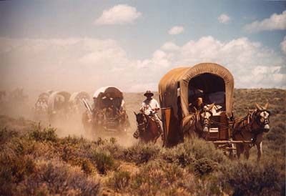
Once again a unified nation, the United States embarked on a period of prosperity and expansion.
Advances in technology led to great leap forwards in productivity and the accumulation of wealth.
Settlers continued to push westwards across the plains towards California and the lure of wide open plains and landholdings for all who came to America brought thousands of new immigrants from Europe.
This was the dawn of the Industrial Revolution in America, a time of huge social and economic change…

